Slide 1
MENU OPTIMIZATION STARTEGY FOR HOTEL BUSINESS

Slide 2
Why Menu Optimization Matters?
“A hotel’s menu isn’t just about food - it’s a business strategy.”
- A well-designed menu can increase profits by 10–15%
- Helps balance customer preferences and business goals
Focus areas:
Profitable dishes
Popular dishes
High food cost items
Smart combos and pricing

Slide 3
PROFIT VS POPULARITY
Popular ≠ Profitable
But Profitable + Popular = Business Win
Why it Matters?
Hotels often promote best-selling dishes (popular), but don’t realize they may:
Have low profit margins
Use too many costly ingredients
Take longer to prepare, affecting service speed
That’s bad for business long term
Menu optimization helps spot this gap and fix it.

Slide 4
Dish-Level Profit Analysis
Dish | Selling Price | Ingredients Cost | Profit | Profit Margin
Paneer Butter Masala | ₹280 | ₹210 | ₹70 | 25%
Egg Masala | ₹200 | ₹60 | ₹140 | 70%
Profit Margin = (Profit ÷ Selling Price) × 100
Paneer Butter Masala – Low Profit, High Orders (Popular Dish)
Egg Masala – High profit, Low orders (Profit Dish)

Slide 5
Menu Engineering Matrix
 | High Popularity | Low Popularity
High Profit | ⭐ Stars – Promote more | ❓ Puzzles – Need marketing/price tweak
Low Profit | 🐴 Plow Horses – Reduce cost/portion | 💣 Dogs – Remove from menu

Slide 6
Action Plan Based on Menu Categories
Category | Action Plan
⭐ Stars | • Keep them at the top of the menu • Use attractive visuals or symbols to highlight
❓ Puzzles | • Rebrand or rename for better appeal • Improve visibility in menu layout • Offer combos or chef’s specials
🐴 Plow Horses | • Reduce ingredient cost (e.g., use less cream or premium items) • Slightly reduce portion size
💣 Dogs | • Consider removing from menu • Only keep if essential for tradition, variety, or niche audience

Slide 7
Menu Engineering Matrix
1. Stars: Keep them on top of menu, highlight them visually
2. Puzzles: Highlight them, rename, or change placement, make combo offers or visually highlight it to increase sale
3. Plow Horses: Keep them, but find ways to reduce cost (eg: Reduce portion size slightly or switch to cheaper ingredients (use less creams))
4. Dogs: Remove or replace from menu unless they are emotionally important or needed for variety

Slide 8
Combo Strategy
Dish | Selling Price | Ingredients Cost | Profit
Egg Masala | ₹150 | ₹90 | ₹60
Jeera Rice | ₹100 | ₹60 | ₹40
💡 Combo Offer at ₹280
We offer this combo at a flat ₹280.
Selling Price (Combo): ₹280
Total Ingredient Cost: ₹190
Profit: ₹280 - ₹190 = ₹90
Payasam | ₹70 | ₹40 | ₹30
Total | ₹320 | ₹190 | ₹130

Slide 9
Why Combo Works
Boosts Total Sales – Customers buy more items together, increasing the bill value.
Sells Slow Items – Combos help move dishes like rice/sweets that are usually ignored.
Feels Like a Deal – Customers love discounts and convenience, so they feel happy and return.

Slide 10
Understanding Food Cost
Purpose: Shows how much you spend to produce a dish
Food Cost % = (Ingredient Cost / Selling Price) × 100
Dish | Selling Price | Ingredient Cost | Food Cost (%)
Egg Masala | ₹150 | ₹60 | 40%
Paneer B. Masala | ₹280 | ₹210 | 75%
👉 Lower Food Cost = Higher Profit Margin

Slide 11
Strategies for High Food Cost Dishes
If Food Cost > 70% → Not ideal
Options:
Reduce ingredient cost (portion, substitutions)
Increase price (if dish is popular)
Convert to combo (add low-cost items)

Slide 12
Customer Psychology in Menu Design
People read menus in a Z-Pattern
Top-left → Top-right → Bottom-left → Bottom-right
Place Star items in top-right & bottom-right
Use boxes, bold fonts, photos to highlight dishes
Spotlight 1 item per page → 30% more orders

Slide 13
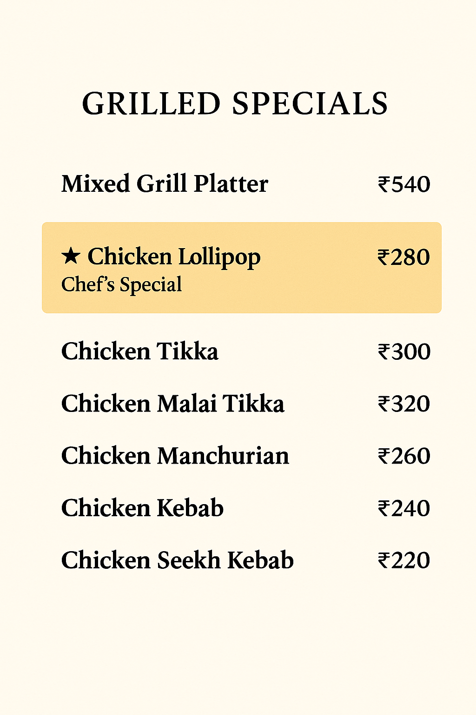
Decoy Pricing Strategy
Objective: Add one overpriced dish to make the mid-range one attractive

Slide 14
Delectable Descriptions & Strategic Pricing
Instead of “Paneer Butter Masala” - ₹249, write:
"Soft cubes of fresh paneer simmered in a rich, buttery tomato gravy infused with fragrant spices — a timeless North Indian classic - 249 “
Tips:
Avoid ₹ sign (write 249, not ₹249) to reduce price sensitivity
Blend price at end of description
Use sensory words (juicy, housemade, crisp)
Add Icons or Badges for Visual Cues :🌶️ Spicy, 🏆 Chef’s Special, 💰 Value Combo
Avoid round numbers.(put ₹199, not ₹200)
Bundle value pricing like “Thali at 349 (worth 450)”

Slide 15
Continuous Optimization
Great menus are never final
Review sales data quarterly
Adjust based on:
- Food cost changes
- Trending dishes
- Seasonal preferences
Use your staff to promote stars (train waiters on what to recommend)
Introduce combos from popular pairings

Slide 16
Business Impact of Menu Optimization
Benefit | Result
Higher Profit Per Order | Increased monthly revenue
Better Guest Experience | Higher satisfaction + loyalty
Reduced Kitchen Chaos | Faster prep, easier training
Less Inventory Waste | Cost control, more sustainability
Improved Brand Perception | Premium feel, smart positioning

Slide 17
Final Summary
Menu Optimization is not a trend — it’s a proven method
Backed by real-world restaurant success
Works for hotels, cafés, fine dining, casual
Requires data + creativity + consistency
🎯 A well-optimized menu = More profit, happy guests, smarter business.

Slide 18
Thank You

